Slide 1
DevOps Session For BT Panorama

Slide 2
DevOps Pipeline View
DevOps Pipeline View for CICD
Total 8 Jobs needs to create.
Git
War
Smoke Test
Compile
Static Analysis
Unit Testing
To Artifact
Cobertura
First Job in Pipeline
Linked to master branch
Monitor Bitbucket for commit action (Poll SCM)
Copy project(Artifacts) from master branch Bitbucket
Pass the Artifacts to next Job.
Git

Slide 3
DevOps Pipeline View
DevOps Pipeline View for CICD
Git
War
Smoke Test
Compile
Static Analysis
Unit Testing
To Artifact
Cobertura
Second Job in Pipeline
Get Artifacts from Git Job
Delete Workspace before compile.
Compile the project with goal as clean
Pass the Artifacts to next Job.
Compile

Slide 4
DevOps Pipeline View
DevOps Pipeline View for CICD
Git
War
Smoke Test
Compile
Static Analysis
Unit Testing
To Artifact
Cobertura
3rd Job in Pipeline
Get Artifacts from Compile Job
Delete Workspace before compile.
Build the project with goal as sonar:sonar
Pass the Artifacts to next Job.
Static Analysis

Slide 5
Jenkins and Devops
Jenkins, originally called Hudson, is an open source Continuous Integration tool written in Java
Firstly, Jenkins is easy to use. The user interface is simple, intuitive, and visually appealing, and Jenkins as a whole has a very low learning curve.
Hundreds of open source plugins are available. These plugins cover everything from version control systems, build tools, code quality metrics, build notifies, integration with external systems, UI customization, games, and much more. And installing them is quick and easy.

Slide 6
DevOps as “Dev” and “Ops.”
DevOps is a cultural shift that is responsible for improving collaboration among the development and operations teams.
Development and IT operations synchronize with each other to speed up the application software development process.

Slide 7
Steps Involved in the DevOps Lifecycle
Continuous Development
The development stage implies its literal meaning in the fact that software development happens in this phase. The whole development process involves the creation of small development cycles for the complete project. As a result, developers can find better opportunities for faster application development.
Continuous Integration
The process of continuous integration follows immediately after the development stage. The different activities in this stage include planning for tests in the next phase. Most important of all, continuous integration involves understanding code for producing the desired results. The advantage of continuous development in DevOps is due to the facility of continuous integration and testing.
Continuous Testing
The next important step in any DevOps introduction on lifecycle refers to testing. The quality assurance teams utilize tools such as Selenium for identifying and resolving bugs in new code.

Slide 8
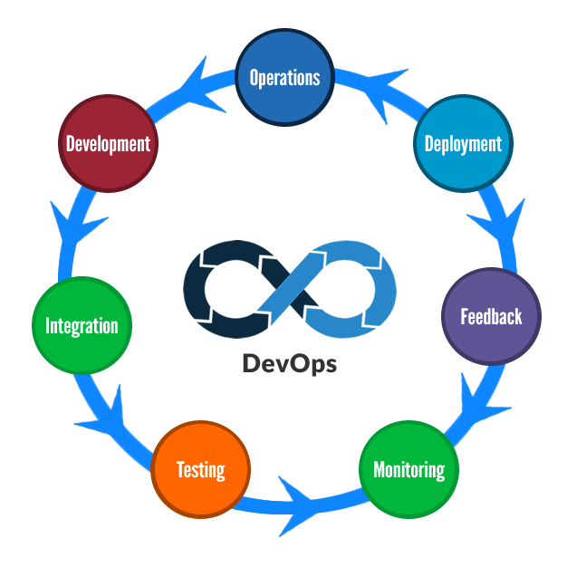
DevOps Process

